Slide 1
FOOD COURT SAATHI

Slide 2
INTRODUCTION
Food court payment system aims at providing reliable yet easy to use method for the purpose of ordering food form various shops registered on the application.
The system is an online application that can be accessed throughout the food court and outside as well with proper login provided which gives the user flexibility of ordering the food from their favourite listed shop.
This software package can be readily used by non-programming personal avoiding human handled chance of error.

Slide 3
DESCRIPTION
This system of ordering and payment consists of following three modules :
A money collector WebApp.
A Shopkeeper WebApp.
A customer mobile App.
Money collector at the main counter by logging in has the access to transfer Digital Tokens by taking hard cash and also register for shops.

Slide 4
Shop owner representatives can also sign up to get registered their shops and can also add and update menu of their shops.
Customer signup into the app and get tokens from collector.
Every Customer which is logging in through the mobile app has access to various menu of all the registered shops. Customer can buy foods and beverages in exchange of tokens.

Slide 5
OBJECTIVE
Our project provides the facility to get access to the list of Foods and beverages provided by the various shops situated in Food Court and order the edibles according to their choice.
The objectives of the system are:
To reduce queue in front of shops.
Reduced operational time.
No need of exchange of hard cash at every counter.
Transaction security through Block Chain.

Slide 6
TECHNOLOGY
Front -End : HTML,CSS, BootStrap
Back-End : Nodejs ,Blockchain
Android OS

Slide 7
MODULES
There are three modules in the project
Collector
Shop Owner
Customer

Slide 8
COLLECTOR
Task is to collect money(in cash) from customer and transfer respective amount of token to his/her respective wallet.
Other responsibility is to register shops of that locality.
Acts as an Admin of application.
He is the first to login through the web portal which will provide unique identity info.
Then he has access to both the tasks.

Slide 9
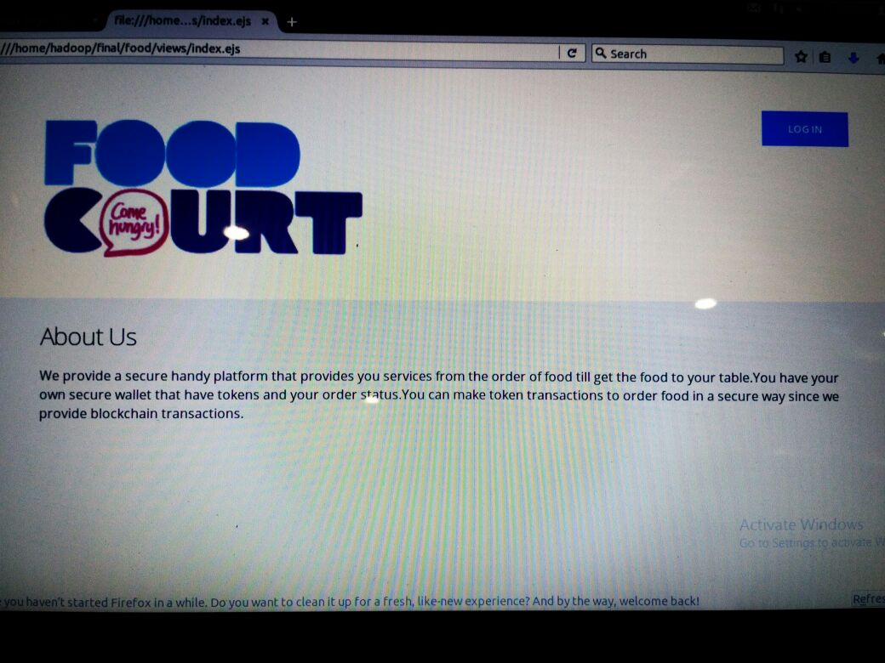

Slide 10
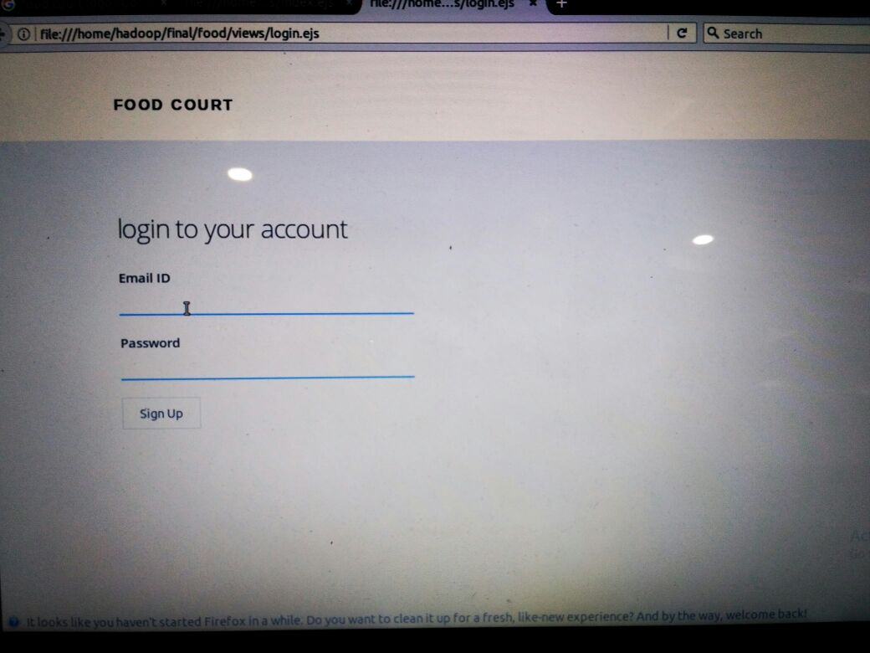

Slide 11
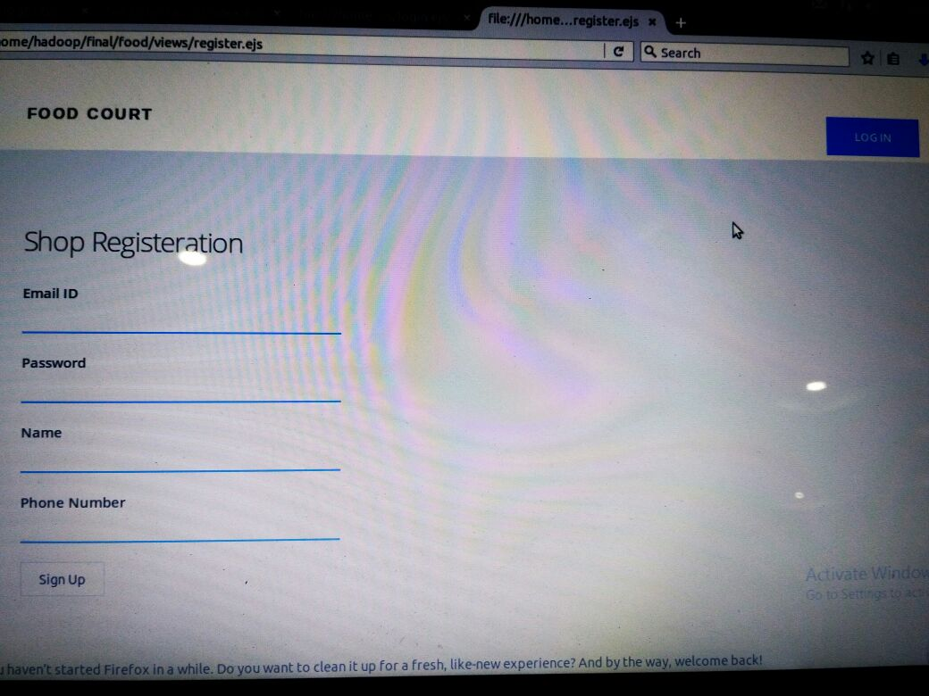

Slide 12
SHOP OWNER
He or she updates the list of food items (menu) that reflect in android app usually.
Get notified when customer order the food.
Get the respective tokens transaction as per menu with customer.
When the order is ready send notification order is ready.

Slide 13
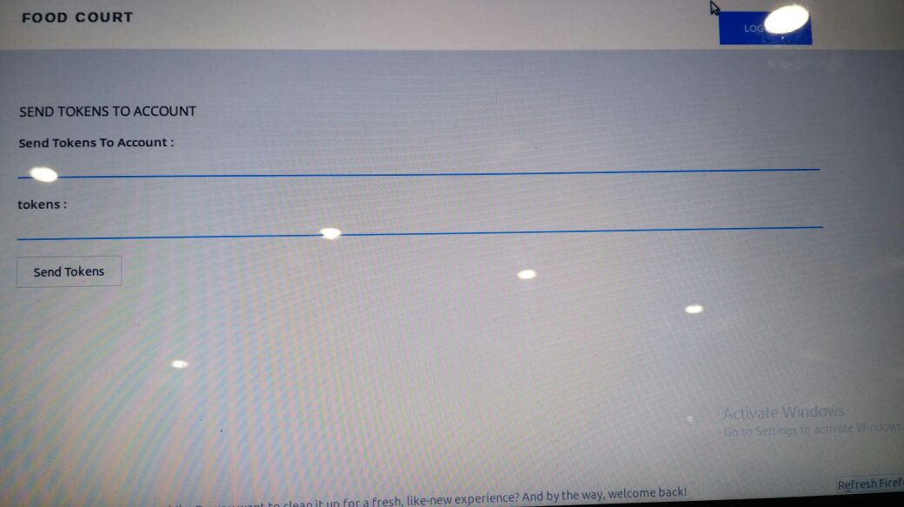

Slide 14
CUSTOMER
The customer is the end-user of the application.
He/She registers himself into the app.
After registration the list of registered shops appear and according to the need the customer can order the food.
Transaction will be Through

Slide 15
USP (The Blockchain Technology)
Our application involves transaction of tokens which is quite risky.
Anyone can easily deny the transaction that happened.
To avoid such condition , our project involves the very new technology The Block Chain.
In this , we record the transaction on distributed ledger.
When transaction of tokens between collector and customer or shopkeeper and customer takes place transaction is saved in the blockchain database.
Since block chain is immutable anyone can get the transaction history and avoid non-repudiation.

Slide 16
IMPLEMENTATION
Shopkeeper registers with the money collector
Customer views the available choices at the registered shops
Customer places his/her order by sharing his/her token number with the shopkeeper
Shopkeeper deducts the required number of tokens from the customer’s account
Shopkeeper notifies the customer about the deducted amount and the order completion time
Customer visits the shop to receive his/her order
Shopkeeper (at the end of the day) goes to the money collector to receive hard cash in exchange of tokens
Customer goes to the money collector to deposit cash
Customer signs up/ signs into his/her account.

Slide 17
Shopkeeper registers with the money collector

Slide 18
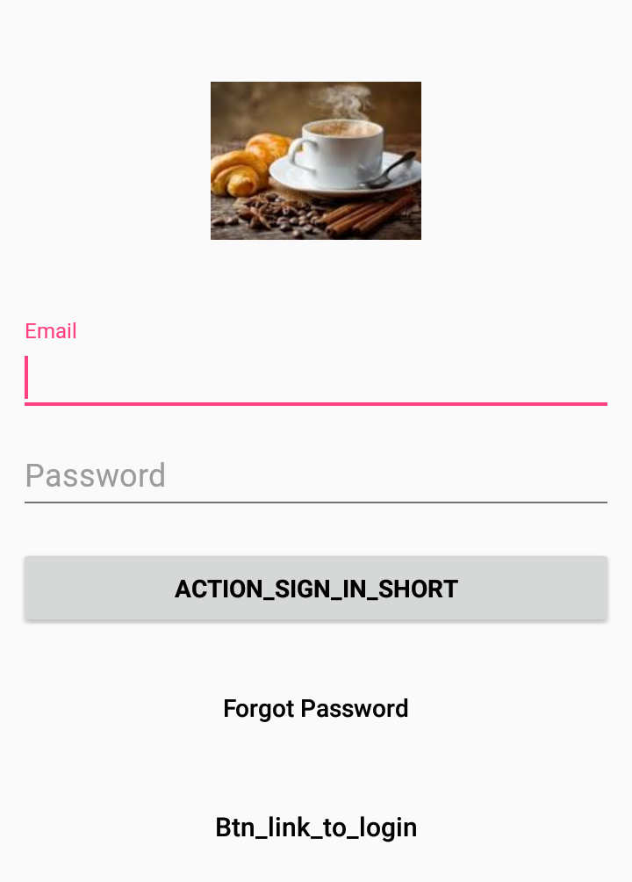
Customer signs up/ signs into his/her account.

Slide 19
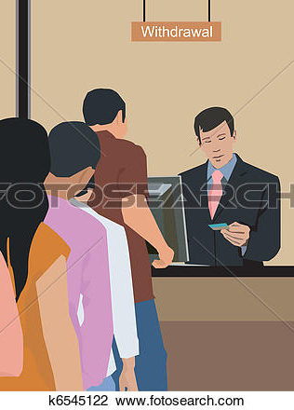
Customer goes to the money collector to deposit cash

Slide 20
Shopkeeper deducts the required number of tokens from the customer’s account

Slide 21
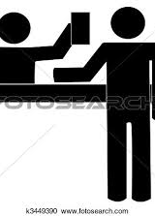
Customer places his/her order by sharing his/her token number with the shopkeeper

Slide 22
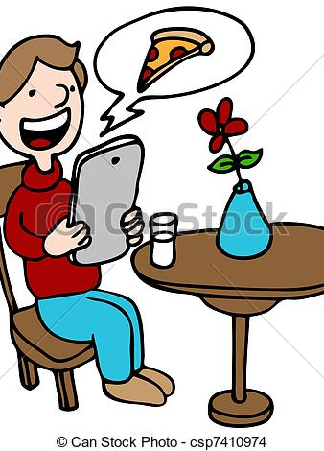
Customer views the available choices at the registered shops

Slide 23
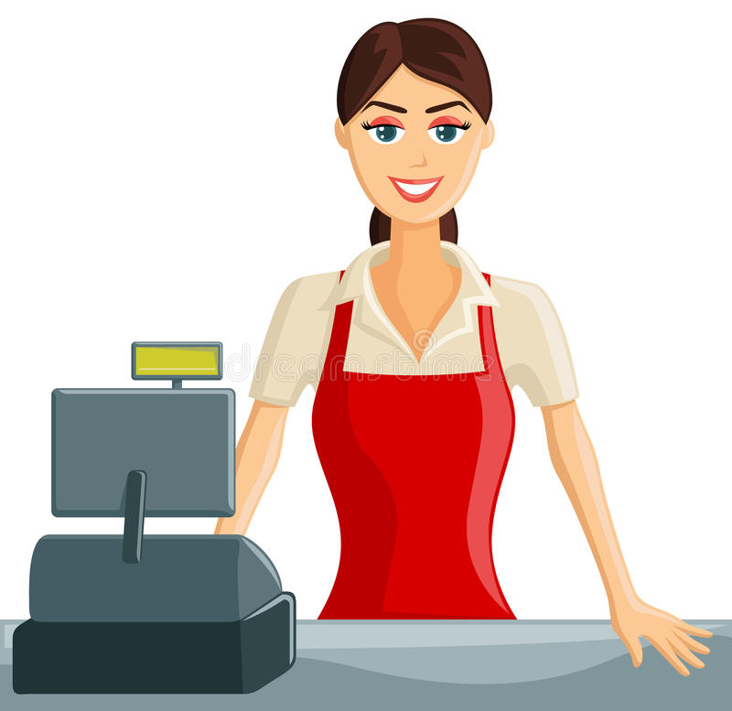
Shopkeeper notifies the customer about the deducted amount and the order completion time

Slide 24
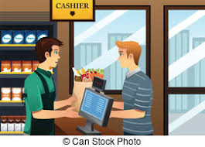
Customer visits the shop to receive his/her order

Slide 25

Shopkeeper (at the end of the day) goes to the money collector to receive hard cash in exchange of tokens

Slide 26
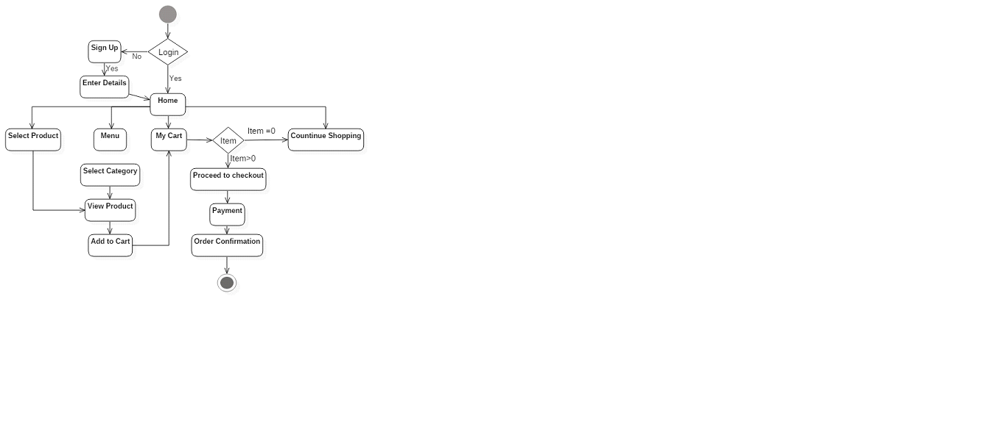
Proposed Architecture(Customer)

Slide 27
Proposed Architecture(Shopkeeper)

Slide 28
Proposed Architecture(Collector)

Slide 29
Application

Slide 30
Application
It provides a digital platform to provide facility of food ordering in very handy way.
It can be applicable in wide rangings like bakeries , bars etc
Not need to keep waiting in long queues for each shops .

Slide 31
Limitations
It involves hard cash transactions.
It has limited scope for particular locality.
It may involve connectivity issues.

Slide 32
Conclusion
It makes the world , a better place for FOODIES.
We can do all kinds of app related tasks in an handy way with friendly UI.
Provides secure token transactions so that no one can deny.
Provides digitally secure , handy platform.

Slide 33
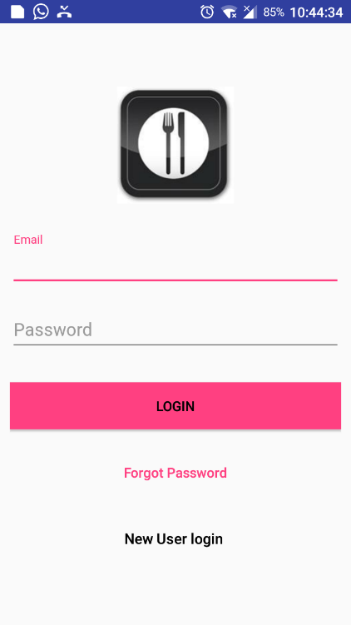
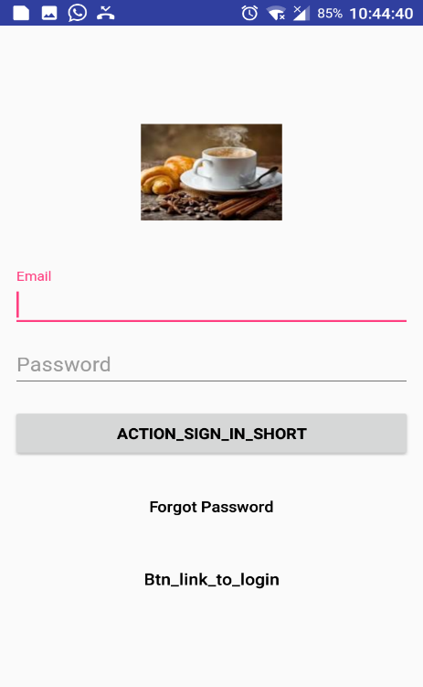
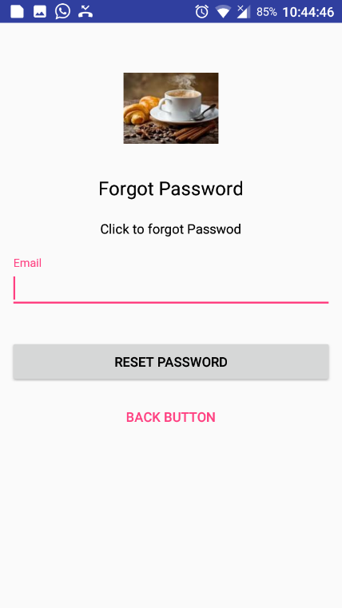

Screenshots

Slide 34
REFERENCES
developer.android.com
androidcetpa.slack.com
tutorialspoint.com/android/
w3schools.com

